Slide 1

Course: Digital Electronics and Logic Design
Course Code: 0705210307
Syllabus of the subject [Credits: 3, Max. Marks: 75 (CA: 30 + ESE: 45), Contact Hours: 2]

Slide 2

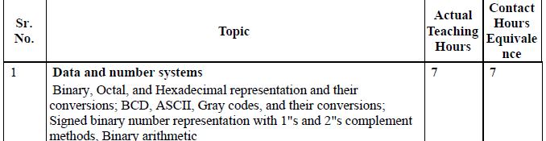


Slide 3

Unit 1- Number System:
Digital means??
a signal expressed as series of the digits 0 and 1
Today, the digital technology is used not only in computers but also in many other applications such as TV, Radar, Military systems, Medical equipment, Communication systems, Industrial process control etc.

Slide 4
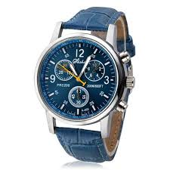
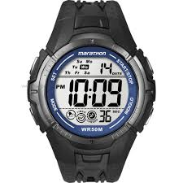
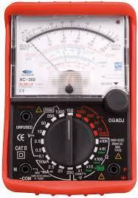

Identify digital device and analog device

Slide 5
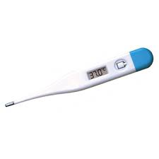
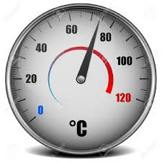
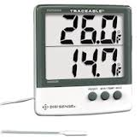
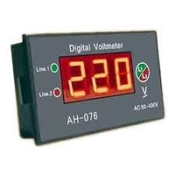
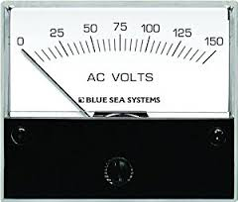

Slide 6
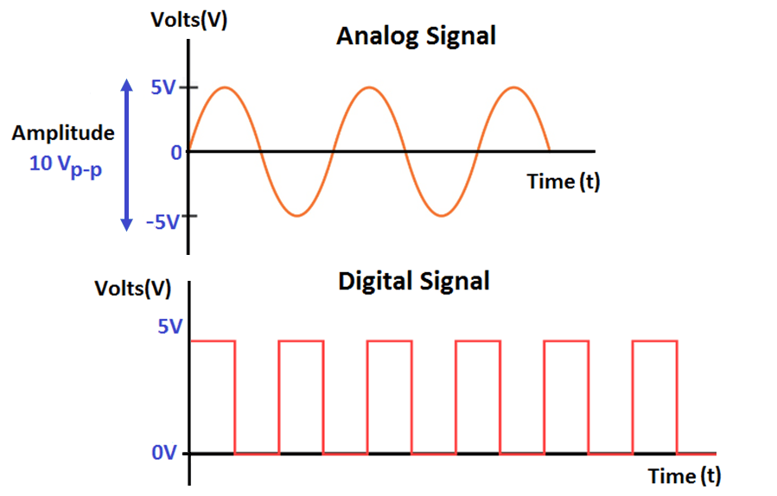
SIGNALS-
It is a physical quantity which contains some information
The signal are classified into two categories.
1. Analog signals:-
They vary continuously with time.
2. Digital signals.
They do not vary continuously with time.
They are discrete with time.

Slide 7
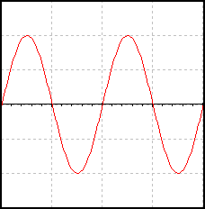
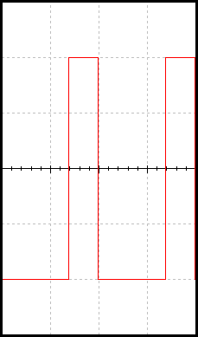
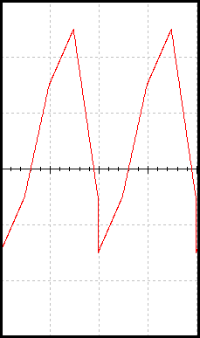
Example of Analog Signals:
An analog signal can be any time-varying signal.
Minimum and maximum values can be either positive or negative.
They can be periodic (repeating) or non-periodic.
Sine waves and square waves are two common analog signals.
Note that this square wave is not a digital signal because its minimum value is negative.
Video and Audio
0 volts
Sine Wave
Square Wave
(not digital)
Random-Periodic

Slide 8
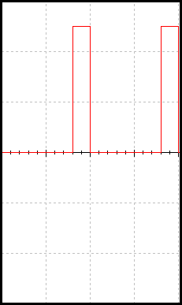
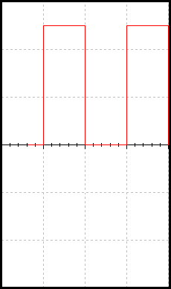
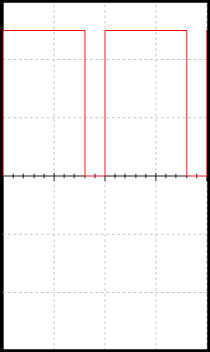
Example of Digital Signals:
Digital signal are commonly referred to as square waves or clock signals.
Their minimum value must be 0 volts, and their maximum value must be 5 volts.
They can be periodic (repeating) or non-periodic.
The time the signal is high (t_{H}) can vary anywhere from 1% of the period to 99% of the period.
Text and Integers.

Slide 9
Advantages of Digital Signal
Digital signal can be processed and transmitted more efficiently and reliably than analog signals.
It is possible to store the data
The effect of noise(unwanted voltage fluctuations) is less. So digital data does not get corrupt.

Slide 10
Comparison of Analog and Digital Signal
Sr.No | Parameter | Analog Signal | Digital Signal
1 | Number of values | Infinite | Finite
2 | Nature | Continuous | Discrete
3 | Sources | Transducers, Signal generator | Computers, A to D Converters
4 | Examples | Sinewave,triangular qwave | Binary signal
5 | Applications | Operational Amplifiers,telephone | Television,Military systems,Microprocessors

Slide 11
Systems or Circuits
Analog Systems:
The system which required analog signals.
Ex- filters, amplifiers.
Digital Systems:
The system which required Digital signals.
Ex- flip flop, shift register, timer, counter.
Sources of Digital Signal:
Computer-All the data used by the computers is digital
A to D Converter

Slide 12
Analog system
Disadvantages:-
Less accurate
Less reliability
Storage & processing data is not possible
Their parameter change with time.
System affected due to noise.

Slide 13
Digital system
Advantages
The have more accuracy.
Highly reliable system
Less affected by noise.
Digital systems have memory hence Information and data can be stored and processed.
Design is easier.
The are less affected by variation of temperature.
They are cost efficient
Communication between the digital systems is much easier

Slide 14
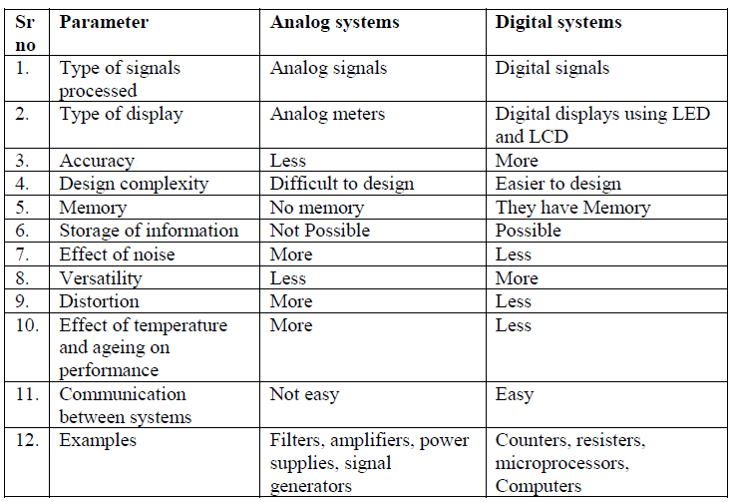
Comparison

Slide 15
Questions
What is signal? Define analog and digital signal.
State advantages of digital signal.
State disadvantages of analog signal
State advantages of digital system.
Compare analog and digital signal.
Compare analog and digital system.

Slide 16
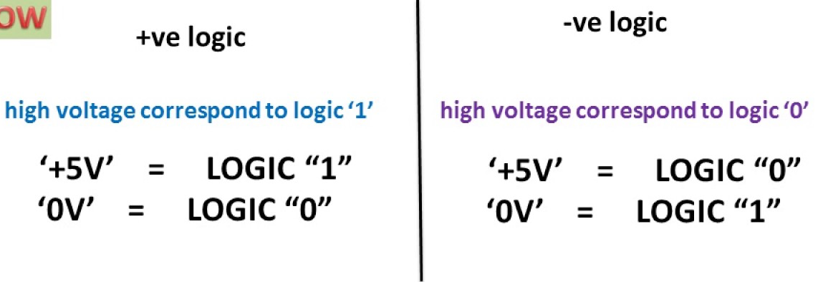
Binary Logic and Logic levels
Statement which is true if some condition is satisfied and false if not satisfied-------Logic
Logic Denoted by two voltage levels—
High level (logic 1)
Low level (logic 0)
Positive logic is defined as a high voltage level representing a logic 1 and a low voltage level representing a logic 0.
Negative logic is the reverse, i.e., a low voltage level represents a logic 1 and a high voltage level represents a logic 0

Slide 17
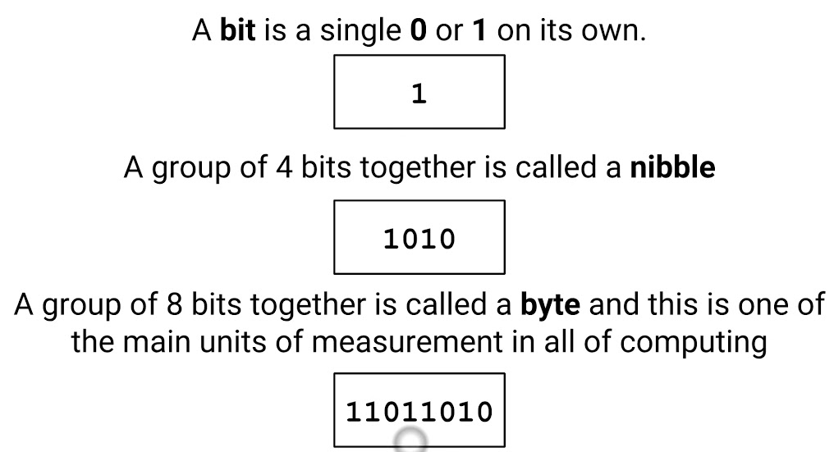
1.1 Terms- Bit, Byte, Nibble

Slide 18
Important Definition
Base or Radix:
The radix or base is the number of unique digits, including the digit zero, used to represent numbers.
For example, for the decimal/denary system (the most common system in use today) the radix (base number) is ten, because it uses the ten digits from 0 through 9.

Slide 19
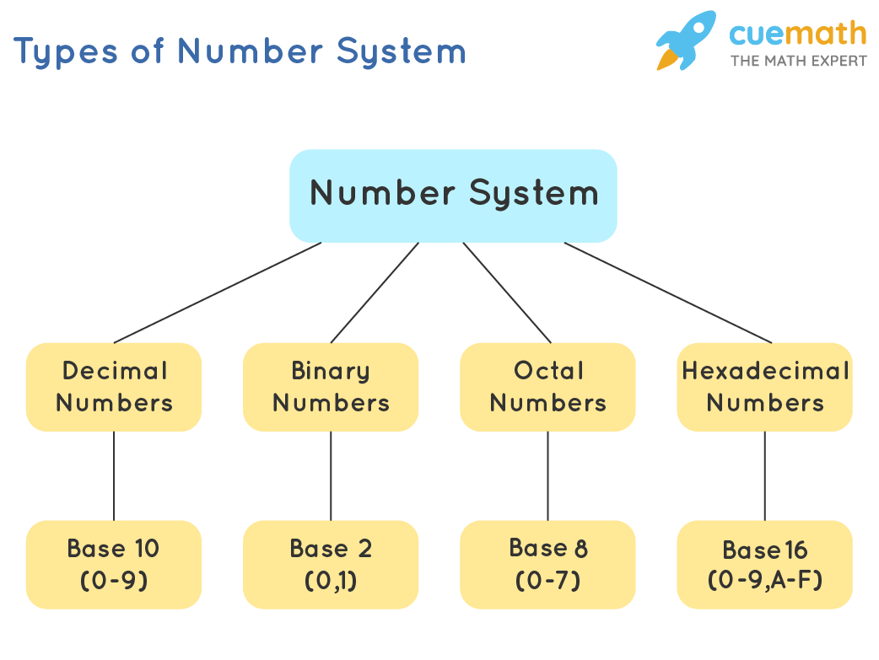
1.2 Number System
A numeral system (or system of numeration) is a writing system for expressing numbers.

Slide 20
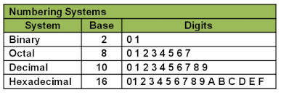
Different types of number systems

Slide 21
Counting
Decimal | Binary | Octal | Hexadecimal
0 | 0000 | 0 | 0
1 | 0001 | 1 | 1
2 | 0010 | 2 | 2
3 | 0011 | 3 | 3
4 | 0100 | 4 | 4
5 | 0101 | 5 | 5
6 | 0110 | 6 | 6
7 | 0111 | 7 | 7
8 | 1000 | 10 | 8
9 | 1001 | 11 | 9
10 | 1010 | 12 | A
11 | 1011 | 13 | B
12 | 1100 | 14 | C
13 | 1101 | 15 | D
14 | 1110 | 16 | E
15 | 1111 | 17 | F
16 | 10000 | 20 | 10
17 | 10001 | 21 | 11
18 | 10010 | 22 | 12

Slide 22
Common Number Systems
System | Base | Symbols | Used by humans? | Used in computers?
Decimal | 10 | 0, 1, … 9 | Yes | No
Binary | 2 | 0, 1 | No | Yes
Octal | 8 | 0, 1, … 7 | No | No
Hexa- decimal | 16 | 0, 1, … 9, A, B, … F | No | No
Then why Octal and Hexadecimal systems used?????

Slide 23
Conversion Among Bases
The possibilities:
Decimal
Octal
Binary
Hexadecimal

Slide 24
Quick Example
25₁₀ = 11001₂ = 31₈ = 19₁₆
Base

Slide 25
Decimal to Decimal
Decimal
Octal
Binary
Hexadecimal
Next slide…

Slide 26
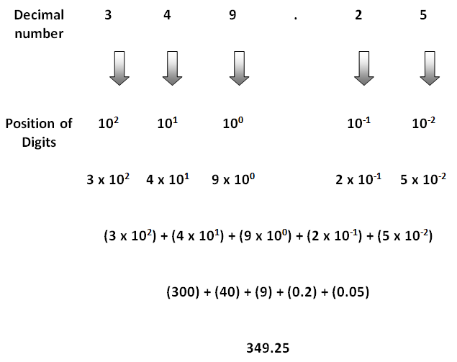
Conversion Decimal to Decimal

Slide 27
Other System into Decimal
(into means Multiplication)
Steps to be followed:
Note down the given number
Write down the weights corresponding to different positions
Multiply each digit in the given number with the corresponding weight
Obtain product number
Add all the product number to get the decimal equivalent.

Slide 28
Binary to Decimal
Decimal
Octal
Binary
Hexadecimal

Slide 29










Conversion Binary to Decimal
MSB
LSB

Slide 30
Solve
Convert following Binary numbers into its Decimal equivalent.
1. (1100010.0101)₂
2. (1011.01)₂

Slide 31
Octal to Decimal
Decimal
Octal
Binary
Hexadecimal

Slide 32
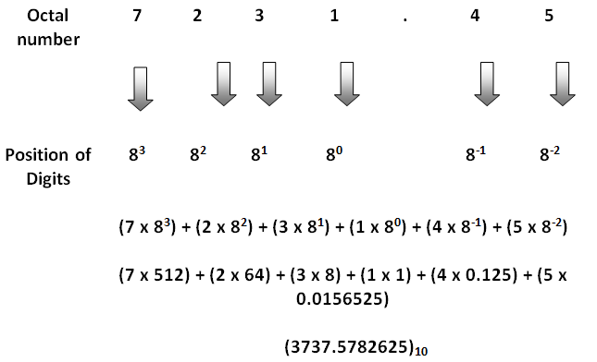

Conversion Octal to Decimal
1. Given Octal Number
2.Multiply each digit by its positional weight
3.Final answer
(7231.45)
8

Slide 33
Solve
Convert following Octal numbers into its Decimal equivalent
(753.41)₈
2. (123.76)₈

Slide 34
Hexadecimal to Decimal
Decimal
Octal
Binary
Hexadecimal

Slide 35
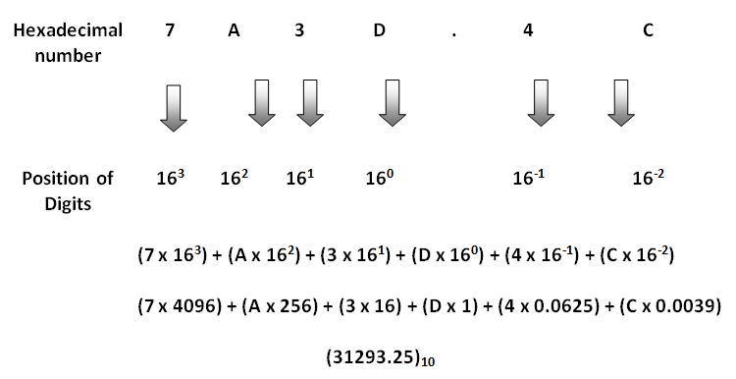
Conversion Hexadecimal to Decimal

Slide 36
Solve
Convert following Hexadecimal numbers to Decimal
(892.41)₁₆
2. (A234.CD)₁₆

Slide 37
Decimal to Binary
Decimal
Octal
Binary
Hexadecimal

Slide 38
Conversion from Decimal into other system
D=Divide
Technique
Divide the decimal number by the base of other system
Continue to divide the quotient by the base until there is nothing left
List the remainder values in reverse order from bottom to top to find the equivalent.

Slide 39
Decimal to Binary
Divide by two, keep track of the remainder
125₁₀ = ?₂
2 125
62 1
2
31 0
2
15 1
2
7 1
2
3 1
2
1 1
2
0 1
125₁₀ = 1111101₂

Slide 40
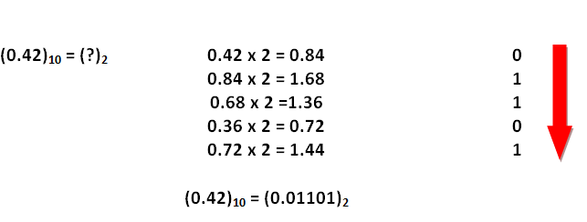
Fractional decimal to binary
We could have continued further. But the conversion is generally carried out only upto 5 digits.

Slide 41
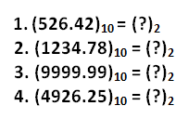
Solve
Convert following decimal numbers to binary

Slide 42
Decimal to Octal
Decimal
Octal
Binary
Hexadecimal
Technique
  Divide by 8
  Keep track of the remainder

Slide 43
Example
1234₁₀ = ?₈
8 1234
154 2
8
19 2
8
2 3
8
0 2
1234₁₀ = 2322₈

Slide 44
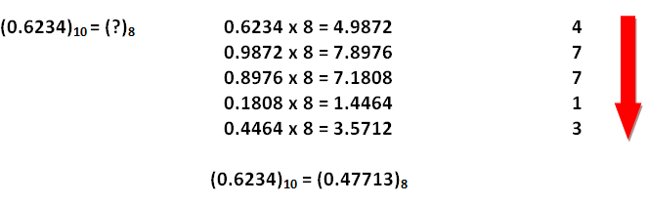
Fractional decimal to octal
Prof. A. Avthankar

Slide 45
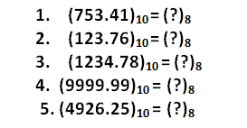
Solve
Convert following decimal numbers to octal.

Slide 46
Decimal to Hexadecimal
Decimal
Octal
Binary
Hexadecimal
Technique
  Divide by 16
  Keep track of the remainder

Slide 47
Example
1234₁₀ = ?₁₆
16 1234
77 2
16
4 13 = D
16
0 4
1234₁₀ = 4D2₁₆

Slide 48
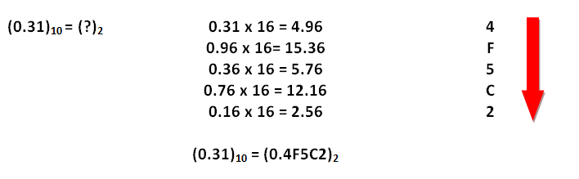
Fractional decimal to hexadecimal

Slide 49
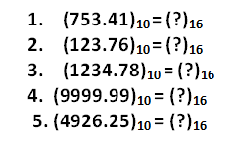
Solve
Convert following decimal numbers to hexadecimal numbers.

Slide 50
Octal to Binary
Decimal
Octal
Binary
Hexadecimal

Slide 51
Octal to Binary
Technique
  Convert each octal digit to a 3-bit equivalent binary representation

Slide 52
Example
705.62₈ = ?₂
7 0 5 . 6 2
111 000 101 110 010
705₈ = 111000101.110010₂

Slide 53
Solve
456.12₈ = ?₂
125.37₈ = ?₂

Slide 54
Hexadecimal to Binary
Decimal
Octal
Binary
Hexadecimal

Slide 55
Hexadecimal to Binary
Technique
  Convert each hexadecimal digit to a 4-bit equivalent binary representation

Slide 56
Example
10AF.C4₁₆ = ?₂
1 0 A F . C 4
0001 0000 1010 1111 1100 0100
10AF.C4₁₆ = 0001000010101111.11000100₂

Slide 57
Solve
45A6.F2₁₆ = ?₂
1CD5.A7₁₆ = ?₂

Slide 58
Binary to Octal
Decimal
Octal
Binary
Hexadecimal

Slide 59
Binary to Octal
Technique
  Group bits in threes, starting on right
  Convert to octal digits

Slide 60
Example
1011010111.011111₂ = ?₈
1 011 010 111 . 011 111
1 3 2 7 3 7
1011010111.011111₂ = 1327.37₈

Slide 61
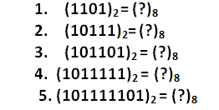
Solve

Slide 62
Binary to Hexadecimal
Decimal
Octal
Binary
Hexadecimal

Slide 63
Binary to Hexadecimal
Technique
  Group bits in fours, starting on right
  Convert to hexadecimal digits

Slide 64
Example
1010111011.00111₂ = ?₁₆
10 1011 1011 . 0011 1000
B B 3 8
1010111011.00111₂ = 2BB . 38₁₆

Slide 65
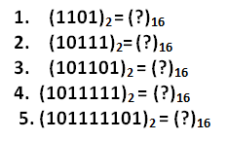
Solve

Slide 66
Octal to Hexadecimal
Decimal
Octal
Binary
Hexadecimal

Slide 67
Octal to Hexadecimal
Technique
  Use binary as an intermediary

Slide 68
Example
1076.4₈ = ?₁₆
1 0 7 6 . 4
0 00 11 1 110 100 0
2 3 E 8
1076.4₈ = 23E.8₁₆

Slide 69
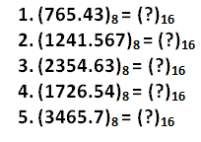
Solve

Slide 70
Hexadecimal to Octal
Decimal
Octal
Binary
Hexadecimal

Slide 71
Hexadecimal to Octal
Technique
  Use binary as an intermediary

Slide 72
Example
1F0C.2₁₆ = ?₈
1 F 0 C . 2
0 001 111 1 00 00 1 100 001 0
1 7 4 1 4 1
1F0C.2₁₆ = 17414.1₈

Slide 73
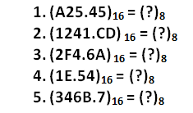
Solve

Slide 74
Exercise – Convert ...
Decimal | Binary | Octal | Hexa- decimal
33 | 100001 | 41 | 21
117 | 1110101 | 165 | 75
451 | 111000011 | 703 | 1C3
 |  |  | 1AF

Slide 75
Exercise – Convert …
Decimal | Binary | Octal | Hexa- decimal
33 | 100001 | 41 | 21
117 | 1110101 | 165 | 75
451 | 111000011 | 703 | 1C3
431 | 110101111 | 657 | 1AF

Slide 76
Exercise – Convert ...
Decimal | Binary | Octal | Hexa- decimal
29.8
 | 101.1101
 |  | 3.07
 |  |  | C.82

Slide 77
Exercise – Convert …
Decimal | Binary | Octal | Hexa- decimal
29.8 | 11101.110011… | 35.63… | 1D.CC…
5.8125 | 101.1101 | 5.64 | 5.D
3.109375 | 11.000111 | 3.07 | 3.1C
12.5078125 | 1100.10000010 | 14.404 | C.82

Slide 78

Binary Arithmetic:
Binary Addition
Four cases of binary addition:

Slide 79
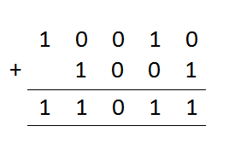
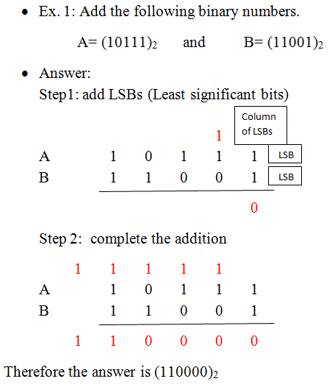
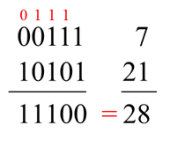
Addition of binary numbers

Slide 80
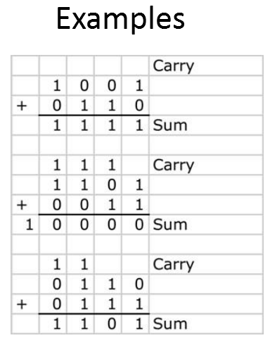

Slide 81
Solve
Add following numbers into binary numbering system.
(12)₁₀ + (8)₁₀
(15)₁₀ + (10)₁₀
(35)₁₀ + (48)₁₀
(10101)₂ + (10110)₂
(10111)₂ + (11000)₂

Slide 82
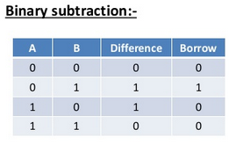
Binary Subtraction

Slide 83
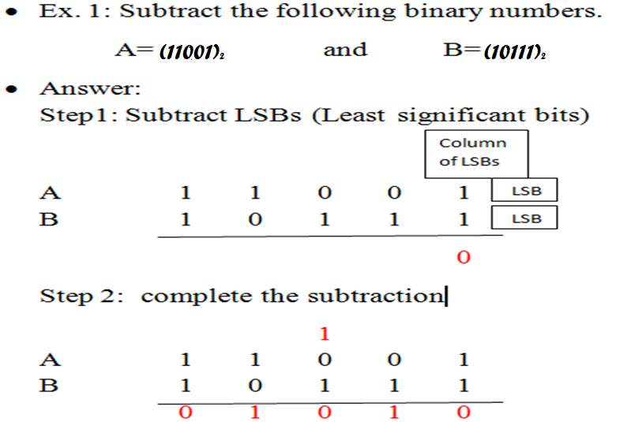
Subtraction of large binary numbers

Slide 84
1’s Complement of a number
1’s complement of a number is found by changing all 1’s to 0’s and all 0’s to 1’s.
Ex: 1’s complement of a number 10111 is = 01000
Solve---- Find 1’s complement of
11010
101101
1010

Slide 85
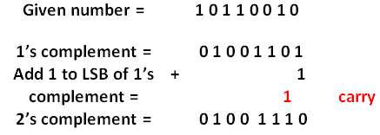
2’s Complement of a number
The 2’s complement of a number is obtained by adding 1 to the LSB of 1’s complement of that number
2’s complement = 1’s complement + 1
Ex: obtain 2’s complement of a number (10110010)₂
Solution:

Slide 86
Binary subtraction using 1’s complement method
To perform subtraction (A)₂ - (B)₂
Step 1: Convert number to be subtracted (B)₂ to its 1’s complement.
Step 2: Add first number (A)₂ and 1’s complement of (B)₂ using rules of binary addition.
Step 3: if final carry is 1 then add it to the result of addition obtained in step 2 to get final result.
**If final carry in step 2 is 1 then result obtained in step 2 is Positive and in its true form no conversion required.
Step 4: if final carry in step 2 is 0 then result obtained in step 2 is negative and in 1’s complement form. So convert it to its true form.

Slide 87
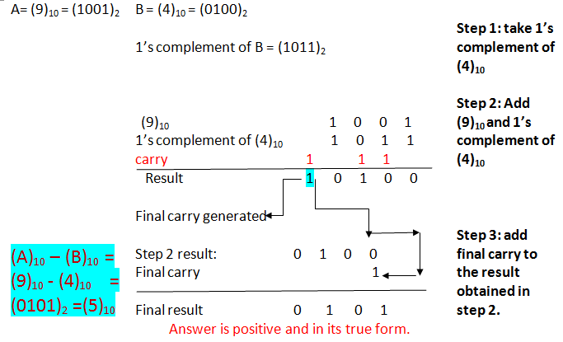
Perform (9)₁₀ – (4)₁₀ using 1’s complement method

Slide 88
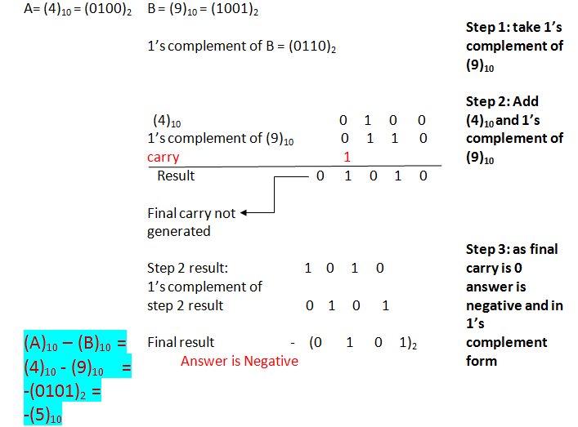
Perform (4)₁₀ – (9)₁₀ using 1’s complement method

Slide 89
Solve
Perform following subtraction using 1’s complement method.
(11011)₂ - (1010)_{2 ans} (10001)₂
(10111)₂ - (11000)_{2 ans} -(0001)₂
(54)₁₀ – (33)_{10 ans} -(010101)₂
(33)₁₀ – (54)₁₀
(99)₁₀ – (22)₁₀

Slide 90
Binary subtraction using 2’s complement method
To perform subtraction (A)₂ - (B)₂
Step 1: convert number to be subtracted (B)₂ to its 2’s complement.
Step 2: Add first number (A)₂ and 2’s complement of (B)₂ using rules of binary addition.
Step 3: if final carry is 1 then the result is Positive and in its true form no conversion required.ult
Step 4: if final carry in step 2 is 0 then result obtained in step 2 is negative and in 2’s complement form. So convert it to its true form.
** Carry always be discarded.

Slide 91
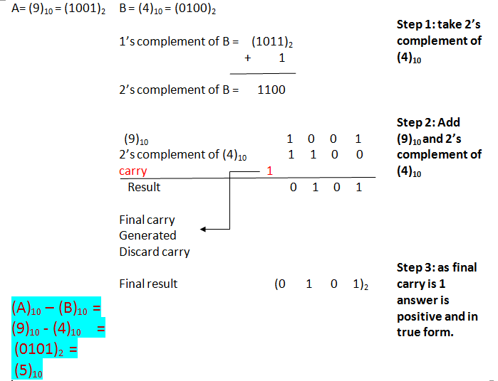
Perform (9)₁₀ – (4)₁₀ using 2’s complement method

Slide 92
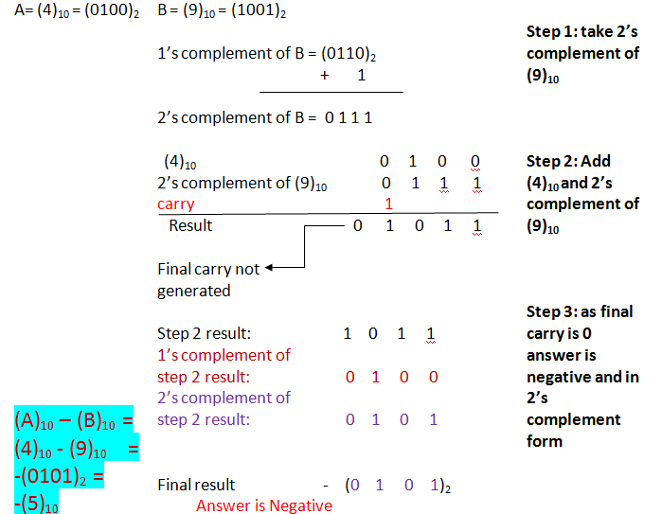
Perform (4)₁₀ – (9)₁₀ using 2’s complement method

Slide 93
Solve
Perform following subtraction using 2’s complement method.
(48)₁₀ – (61)₁₀
(33)₁₀ – (54)₁₀
(99)₁₀ – (22)₁₀
(1010)₂ – (101)₂

Slide 94
Multiplication
Binary, two 1-bit values
A | B | A × B
0 | 0 | 0
0 | 1 | 0
1 | 0 | 0
1 | 1 | 1

Slide 95
Multiplication (3 of 3)
Binary, two n-bit values
  As with decimal values
  E.g.,
1110
x 1011
1110
1110
0000
1110
10011010

Slide 96
Solve
(205)₁₀ x (3)₁₀
(1110101)₂ x (1001)₂
(110)₂ x (10)₂
(1111101)₂ x (101)₂
(15)₁₀ x (8)₁₀

Slide 97
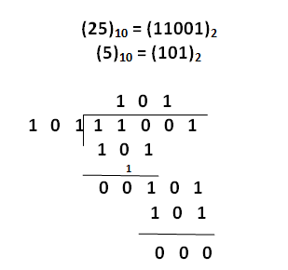
Binary division
Ex: (25)₁₀ ÷ (5)₁₀

Slide 98
Solve
(205)₁₀ ÷ (3)₁₀
(1110101)₂ ÷ (1001)₂
(110)₂ ÷ (10)₂
(1111101)₂ ÷ (101)₂

Slide 99
BCD Code:
BCD code is an abbreviation for Binary coded Decimal codes. ✓ It is a numeric weighted code, in which each digit of a decimal number is represented by a separate group of 4-bits.
There are several BCD codes like 8421, 2421, 3321, 4221, 5211, 5311, 5421, etc.
The most common and widely used BCD code is 8421 code.
In 8421 code, the weights associated with 4 bits are 8, 4, 2, 1 from MSB to LSB.
That is, the weight associated with 3rd bit is 8, the weight associated with 2nd bit is 4, the weight associated with 1st bit is 2 and the weight associated with 0th bit is 1.

Slide 100
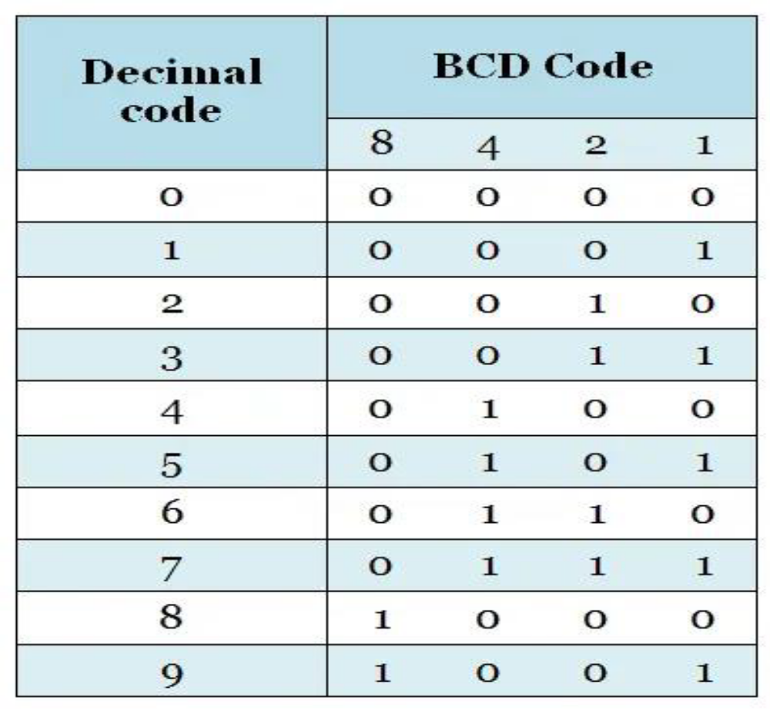
The following table shows the 8421 code for 0-9 decimal numbers.

Slide 101
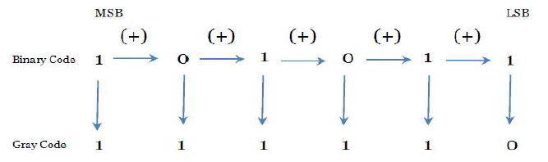
THE GRAY CODE:
BINARY-TO-GRAY CODE CONVERSION
The MSB in the Gray code is the same as corresponding MSB in the binary number.
Going from left to right, add each adjacent pair of binary code bits to get the next Gray code bit. Discard carries.
Ex: Convert (101011)2 to Gray code

Slide 102
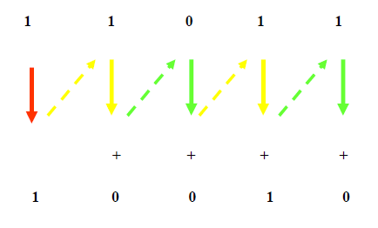
GRAY-TO-BINARY CONVERSION
The MSB in the binary code is the same as the corresponding bit in the Gray code.
Add each binary code bit generated to the Gray code bit in the next adjacent position.
Discard carries.
Ex: Convert the Gray code word 11011 to binary

Slide 103
APPLICATION OF GRAY CODE:
The gray code is used in a few specific applications.
The main applications include being used in analog to digital converters, as well as being used for error correction in digital communication.
Gray code is used to minimize errors in converting analog signals to digital signals.
ADVANTAGES OF GRAY CODE:
Better for error minimization in converting analog signals to digital signals.
Reduces the occurrence of “Hamming Walls” (an undesirable state) when used in genetic algorithms.
Can be used to in to minimize a logic circuit.
Useful in clock domain crossing.
DISADVANTAGES OF GRAY CODE:
Not suitable for arithmetic operations.
Limited practical use outside of a few specific applications.

Slide 104
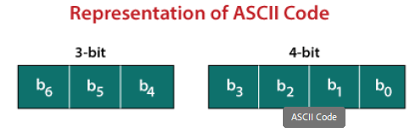
ASCII CODE
The ASCII stands for American Standard Code for Information Interchange.
The ASCII code is an alphanumeric code used for data communication in digital computers.
The ASCII is a 7-bit code capable of representing 27 or 128 number of different characters.
The ASCII code is made up of a three-bit group, which is followed by a four-bit code.
The ASCII Code is a 7 or 8-bit alphanumeric code.
This code can represent 127 unique characters.
The ASCII code starts from 00h to 7Fh. In this, the code from 00h to 1Fh is used for control characters, and the code from 20h to 7Fh is used for graphic symbols.
The 8-bit code holds ASCII, which supports 256 symbols where math and graphic symbols are added.
The range of the extended ASCII is 80h to FFh.

Slide 105

The ASCII characters are classified into the following groups:

Slide 106
CONTROL CHARACTERS
The non-printable characters used for sending commands to the PC or printer are known as control characters.
We can set tabs, and line breaks functionality by this code.
The control characters are based on telex technology. Nowadays, it's not so much popular in use.
The character from 0 to 31 and 127 comes under control characters.
2. SPECIAL CHARACTERS
All printable characters that are neither numbers nor letters come under the special characters.
These characters contain technical, punctuation, and mathematical characters with space also.
The character from 32 to 47, 58 to 64, 91 to 96, and 123 to 126 comes under this category.
3. NUMBERS CHARACTERS
This category of ASCII code contains Ten Arabic numerals from 0 to 9.
4. LETTERS CHARACTERS
In this category, two groups of letters are contained, i.e., the group of uppercase letters and the group of lowercase letters.
The range from 65 to 90 and 97 to 122 comes under this category.

Slide 107

Example 1: (10010101100001111011011000011010100111000011011111101001 1101110 11101 001000000011000101100100110011)2
Step 1: In the first step, we we make the groups of 7-bits because the ASCII code is 7 bit. 1001010 1100001 1110110 1100001 1010100 1110000 1101111 1101001 1101110 1110100 1000000 0110001 0110010 0110011
Step 2: Then, we find the equivalent decimal number of the binary digits either from the ASCII table or 64 32 16 8 4 2 1 scheme.

Slide 108

Step 3: Last, we find the equivalent symbol of the decimal number from the ASCII table.

Slide 109
Thanks

